Slide 1
卷积神经网络 II

Slide 2
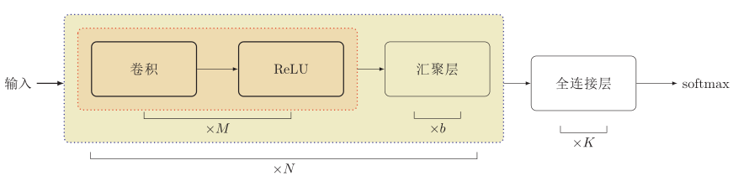
卷积网络结构
卷积网络是由卷积层、汇聚层、全连接层交叉堆叠而成。
趋向于小卷积、大深度
趋向于全卷积
典型结构
一个卷积块为连续M 个卷积层和b个汇聚层（M通常设置为2 ∼ 5，b为0或1）。一个卷积网络中可以堆叠N 个连续的卷积块，然后在接着K 个全连接层（N 的取值区间比较大，比如1 ∼ 100或者更大；K一般为0 ∼ 2）。

Slide 3
其它卷积种类

Slide 4
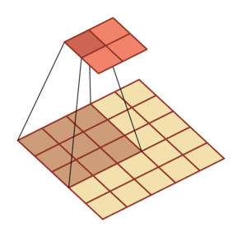
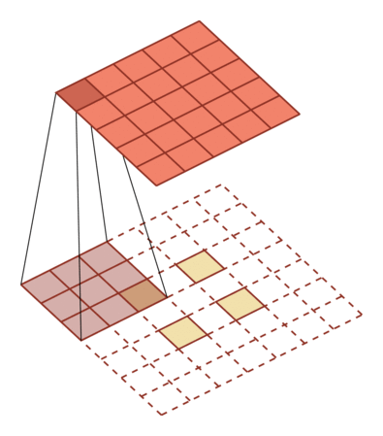
转置卷积/微步卷积
低维特征映射到高维特征

Slide 5
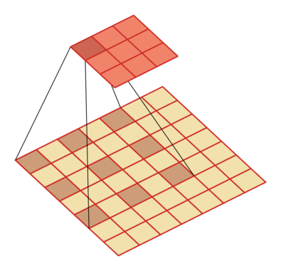
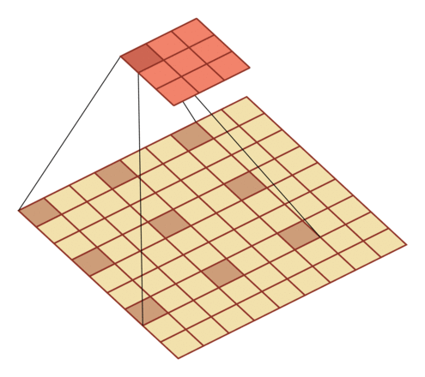
空洞卷积
如何增加输出单元的感受野
增加卷积核的大小
增加层数来实现
在卷积之前进行汇聚操作
空洞卷积
通过给卷积核插入“空洞”来变相地增加其大小。

Slide 6
典型的卷积网络

Slide 7
卷积神经网络
CNN模型结构变迁
针对移动端的轻量型网络
VGGNet
(2014)
ResNet
(2015)
DenseNet
(2016)
NAS
(2018)
LeNet
(1998)
AlexNet
(2012)
NIN(2013)
GoogLeNet
(2014)
SqueezeNet
(2016.02)
MobileNet V3
(2016.04)
ShuffleNet
(2016.06)
Xception
(2016.10)

Slide 8
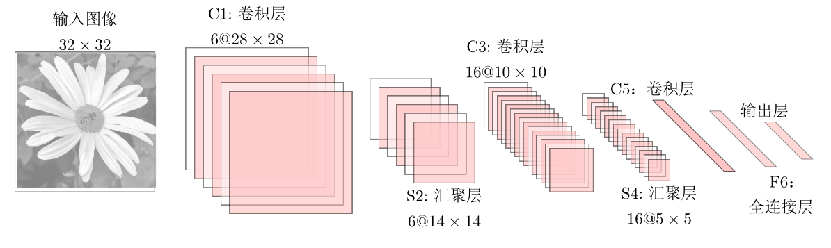
LeNet-5
LeNet-5 是一个非常成功的神经网络模型。
基于 LeNet-5 的手写数字识别系统在 90 年代被美国很多银行使用，用来识别支票上面的手写数字。
LeNet-5 共有 7 层。
需要多少个卷积核？
Notes:
输入层：输入图像大小为 32 × 32 = 1024。
C1 层：这一层是卷积层。滤波器的大小是 5×5 = 25，共有 6 个滤
波器。得到 6 组大小为 28 × 28 = 784 的特征映射。因此，C1 层的
神经元个数为 6 × 784 = 4,704。可训练参数个数为
6 × 25 + 6 = 156。连接数为 156 × 784 = 122,304（包括偏置在内，
下同）。
S2 层：这一层为子采样层。由 C1 层每组特征映射中的 2 × 2 邻域
点次采样为 1 个点，也就是 4 个数的平均。

Slide 9
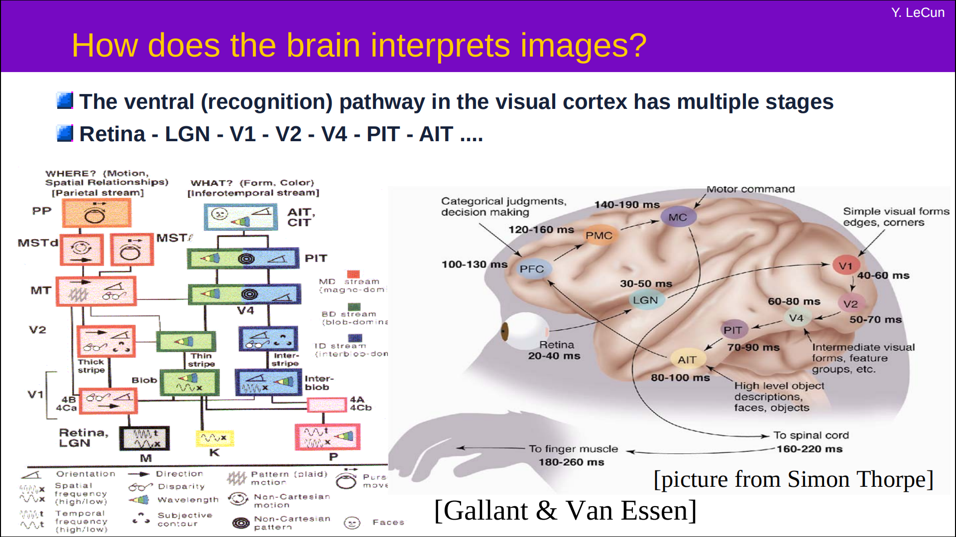
LeNet-5 卷积网络结构

Slide 10
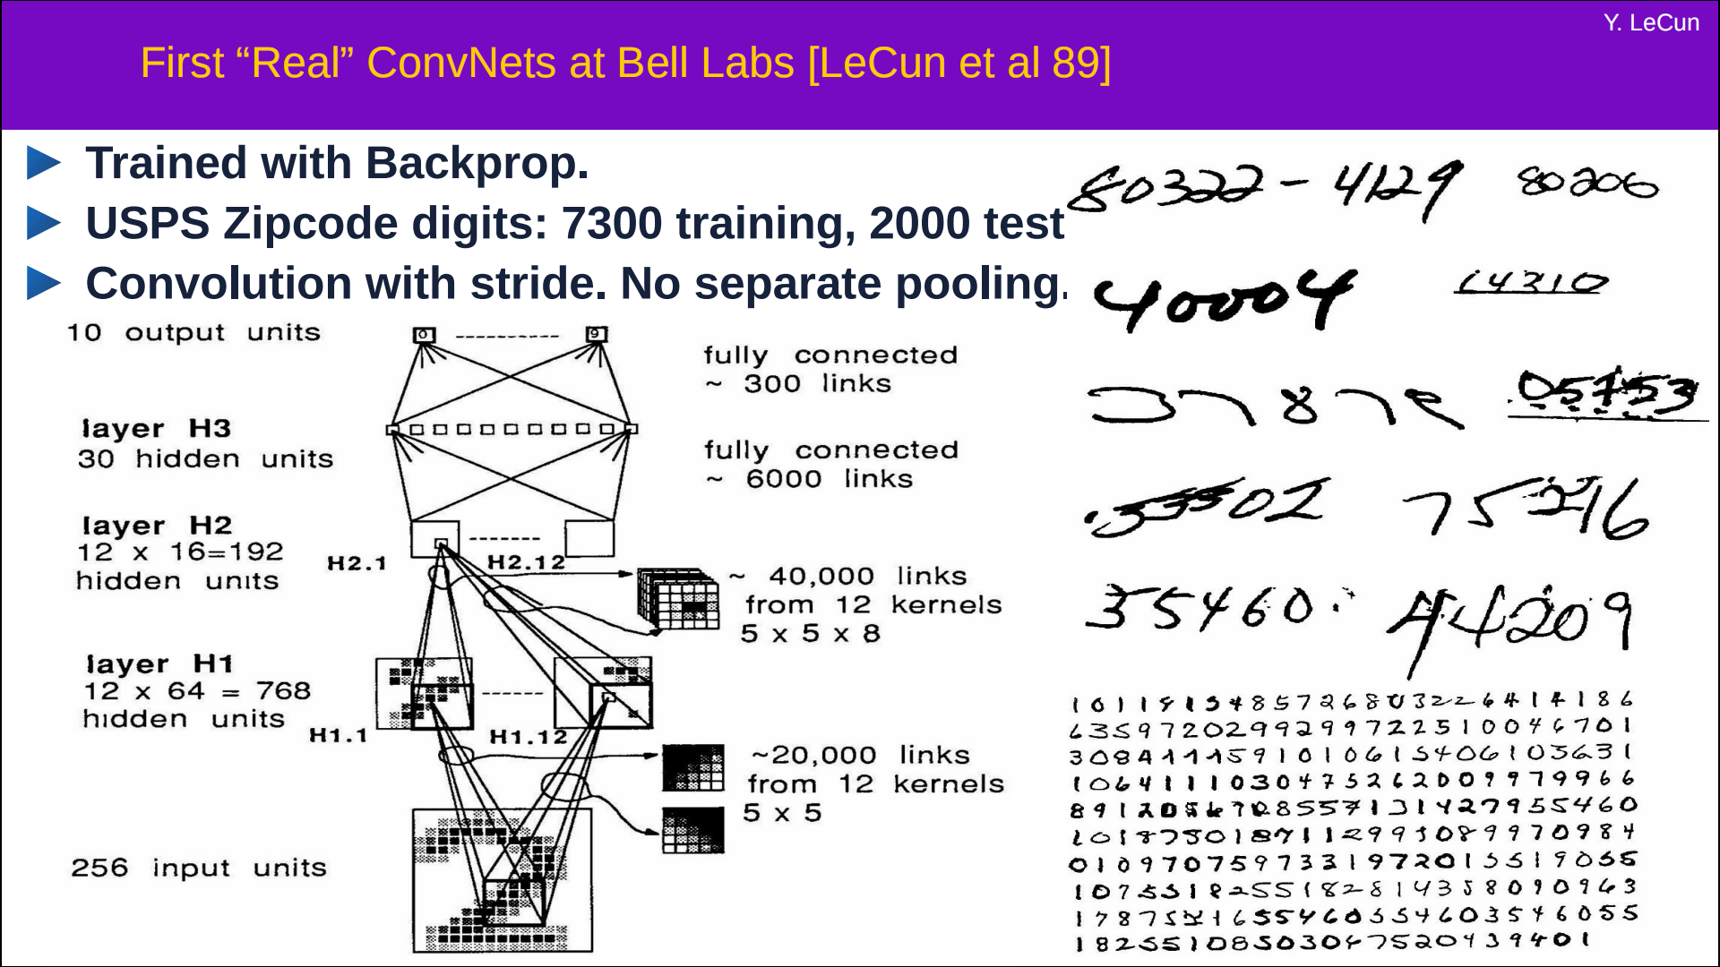
LeNet-5 卷积网络结构

Slide 11
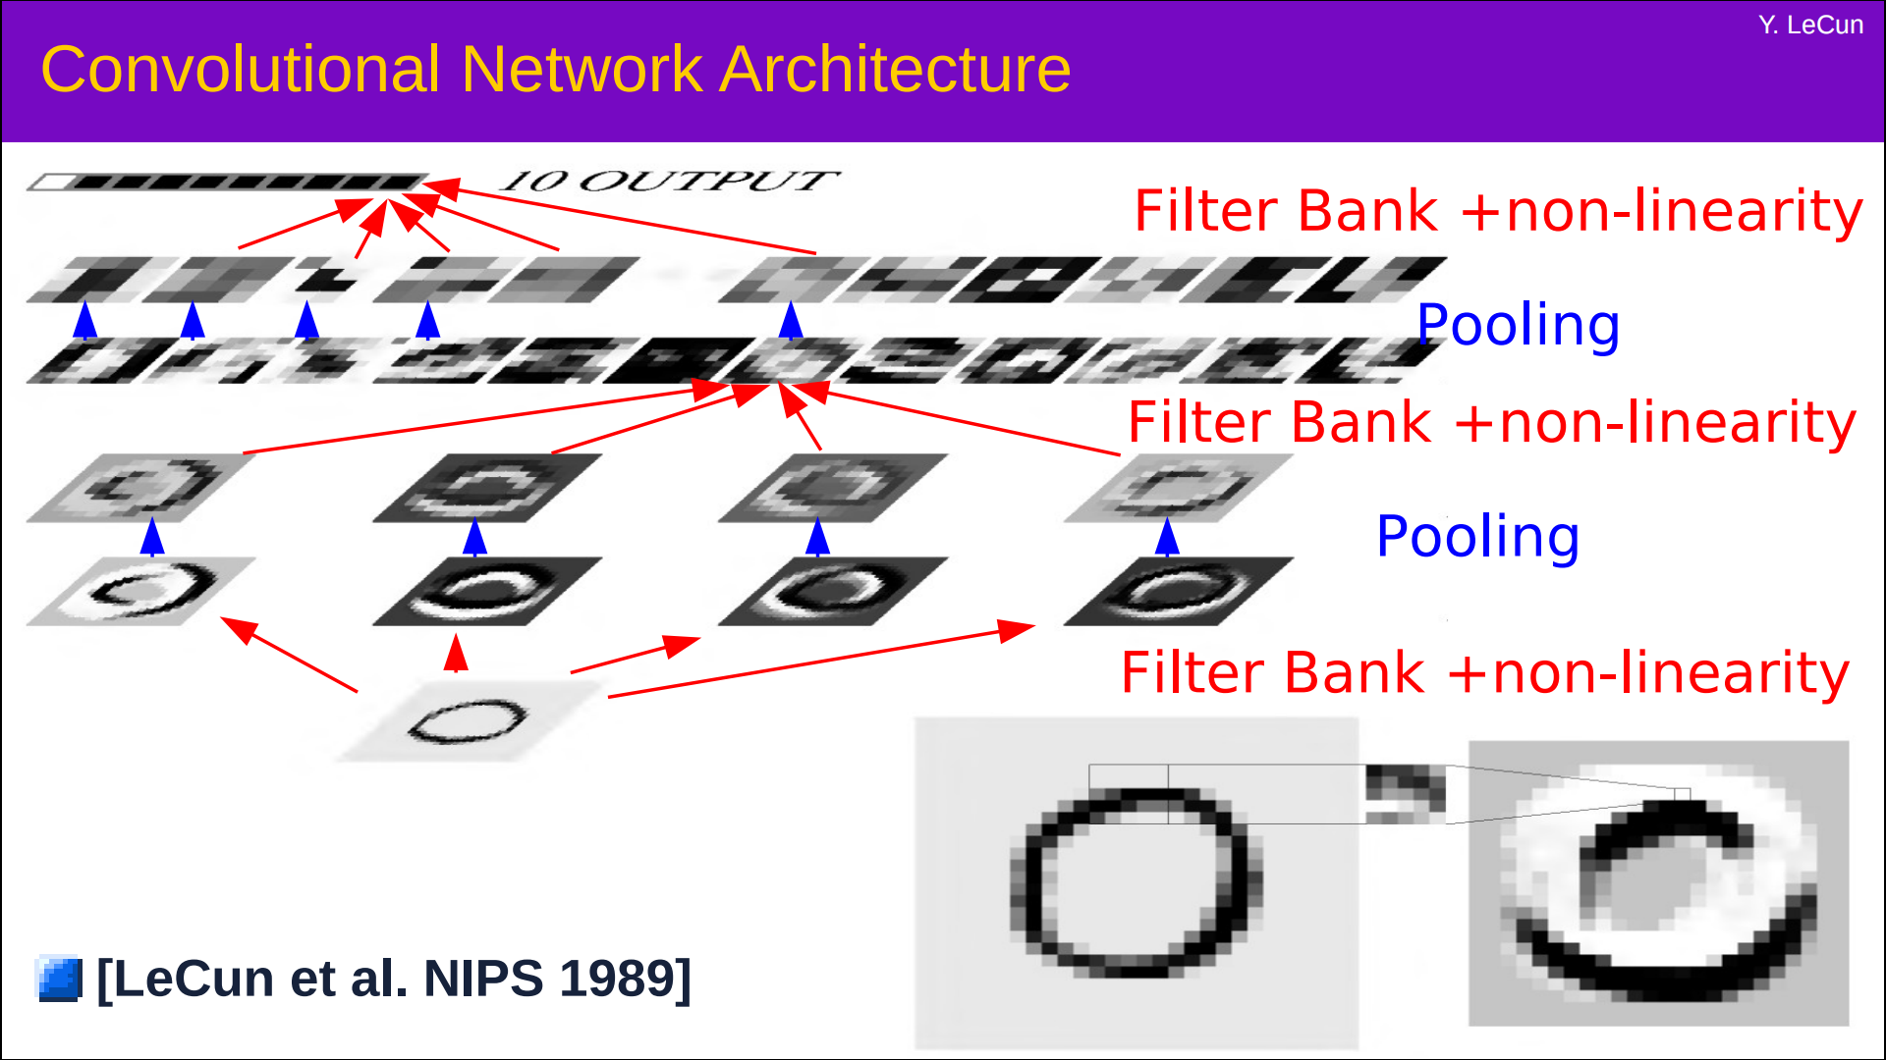
LeNet-5 卷积网络结构

Slide 12
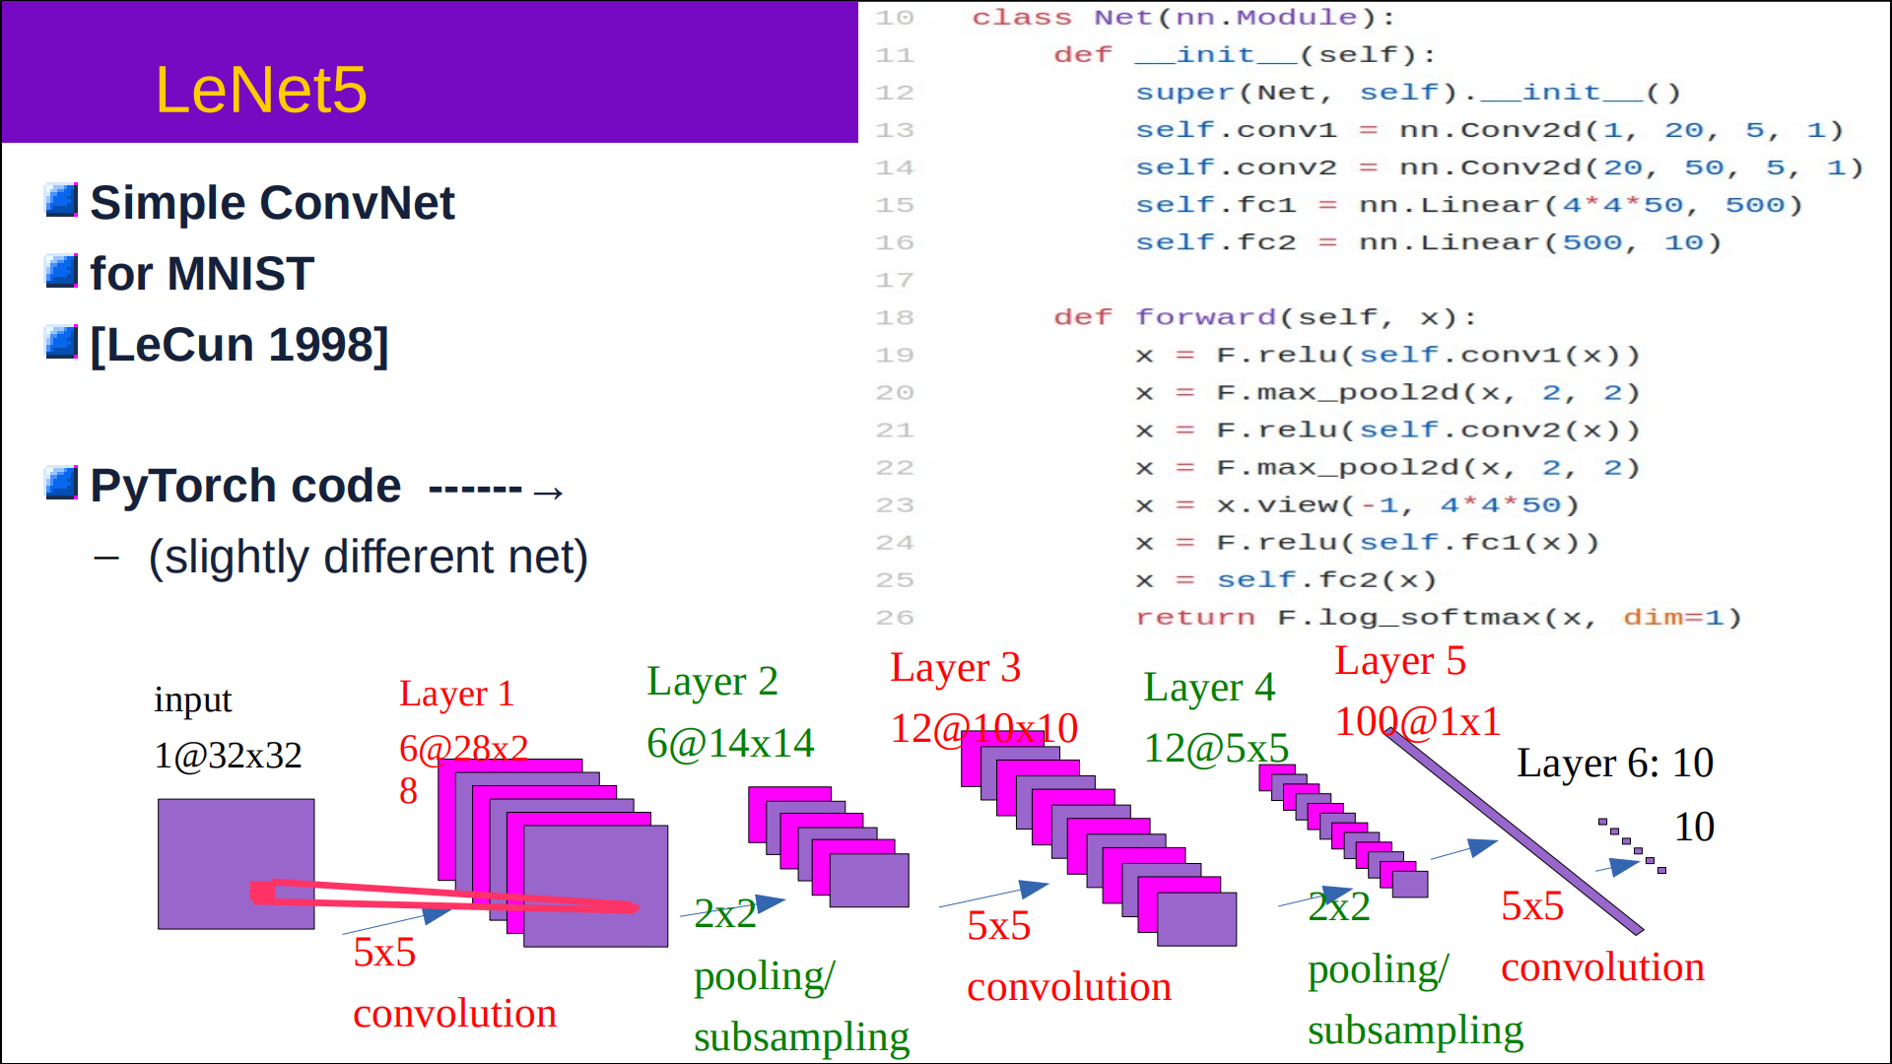
LeNet-5 卷积网络结构

Slide 13
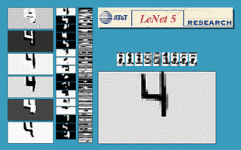
卷积网络结构
https://atcold.github.io/pytorch-Deep-Learning/zh/week03/03-2/

Slide 14
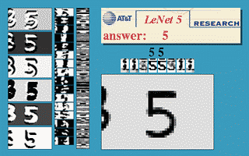
LeNet-5 卷积网络结构
https://atcold.github.io/pytorch-Deep-Learning/zh/week03/03-2/

Slide 15
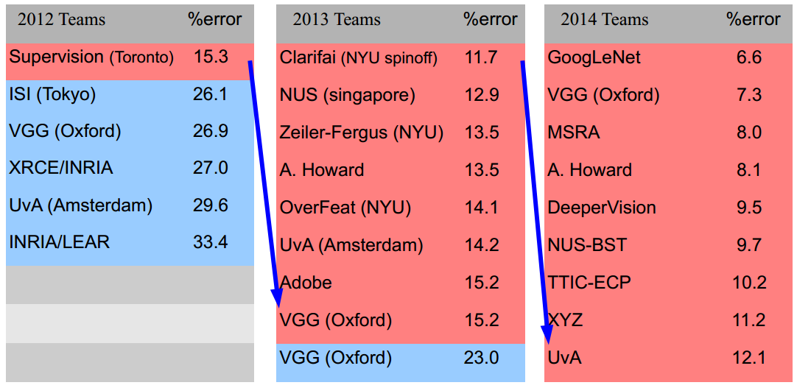
Large Scale Visual Recognition Challenge

Slide 16
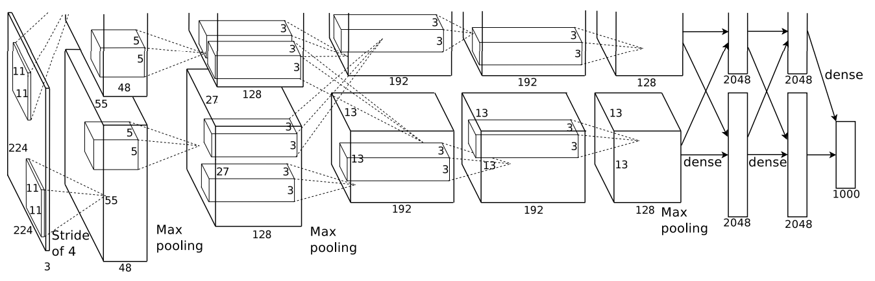
AlexNet
2012 ILSVRC winner
（top 5 error of 16% compared to runner-up with 26% error）
第一个现代深度卷积网络模型，首次使用了很多现代深度卷积网络的一些技术方法，
比如使用GPU进行并行训练，采用了ReLU作为非线性激活函数，使用Dropout防止过拟合，使用数据增强
5个卷积层、3个汇聚层和3个全连接层

Slide 17
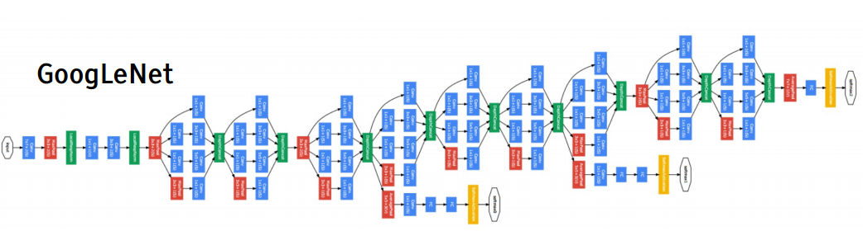
Inception网络
2014 ILSVRC winner （22层）
参数：GoogLeNet：4M VS AlexNet：60M
错误率：6.7%
Inception网络是由有多个inception模块和少量的汇聚层堆叠而成。

Slide 18
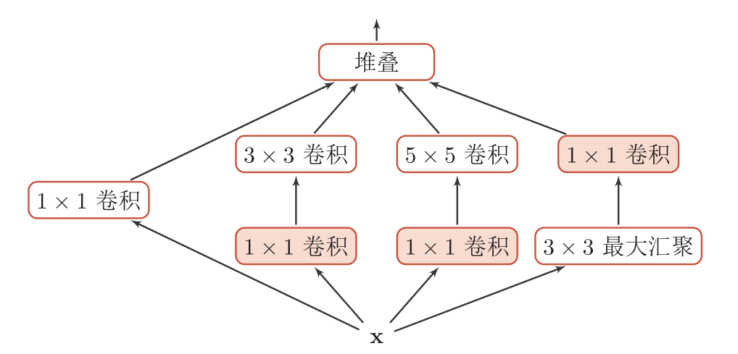
Inception模块 v1
在Inception网络中，一个卷积层包含多个不同大小的卷积操作，称为Inception模块。
Inception模块同时使用1 × 1、3 × 3、5 × 5等不同大小的卷积核，并将得到的特征映射在深度上拼接（堆叠）起来作为输出特征映射。
卷积和最大汇聚都是等宽的。

Slide 19
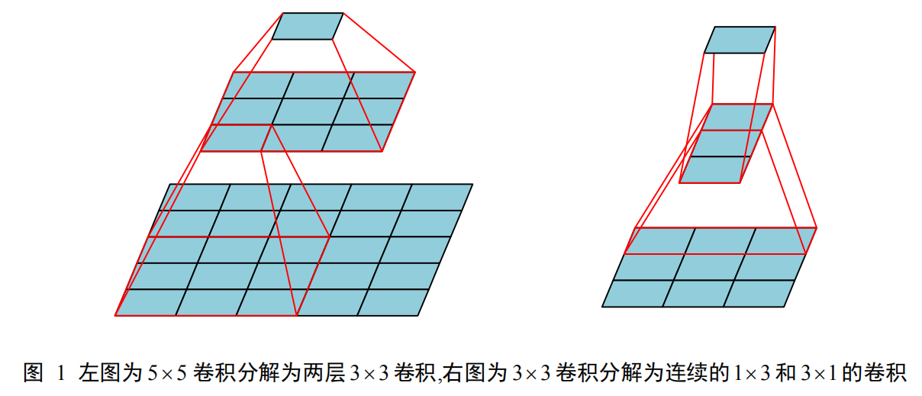
Inception模块 v3
用多层的小卷积核来替换大的卷积核，以减少计算量和参数量。
使用两层3x3的卷积来替换v1中的5x5的卷积
使用连续的nx1和1xn来替换nxn的卷积。

Slide 20
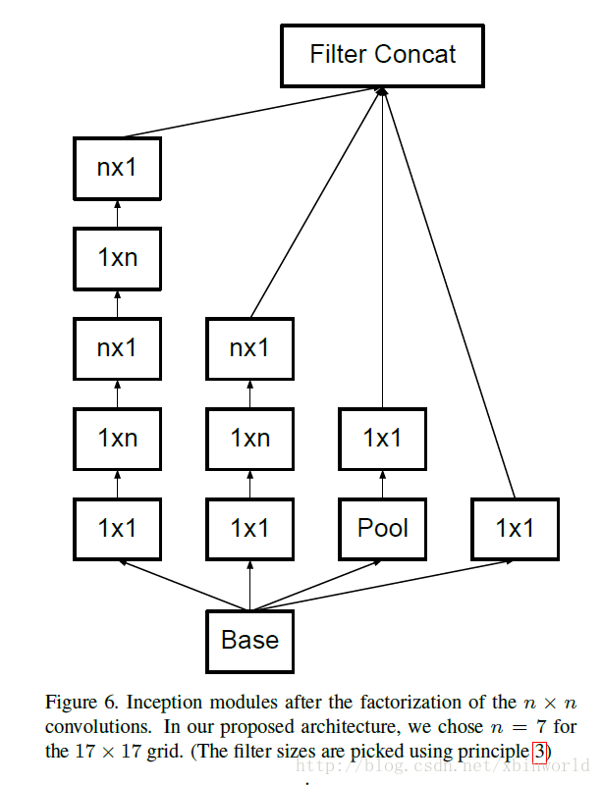
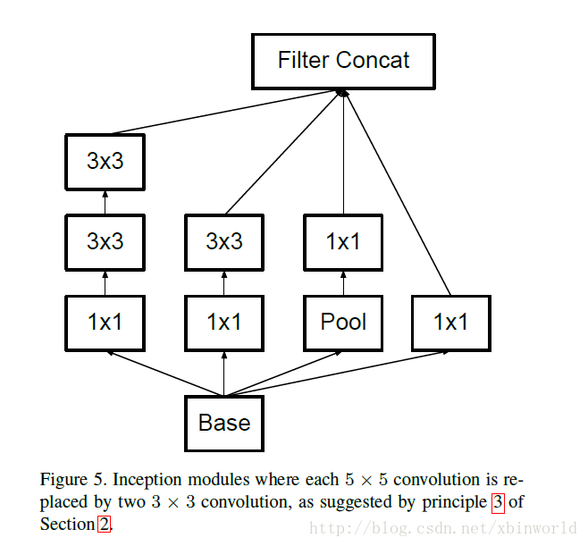
Inception模块 v3
用多层的小卷积核来替换大的卷积核，以减少计算量和参数量。
使用两层3x3的卷积来替换v1中的5x5的卷积
使用连续的nx1和1xn来替换nxn的卷积。

Slide 21
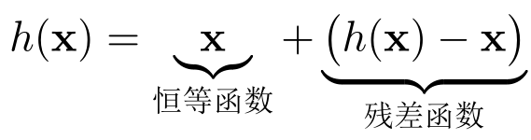
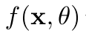
残差网络
残差网络（Residual Network，ResNet）是通过给非线性的卷积层增加直连边的方式来提高信息的传播效率。
假设在一个深度网络中，我们期望一个非线性单元（可以为一层或多层的卷积层）f(x,θ)去逼近一个目标函数为h(x)。
将目标函数拆分成两部分：恒等函数和残差函数

Slide 22
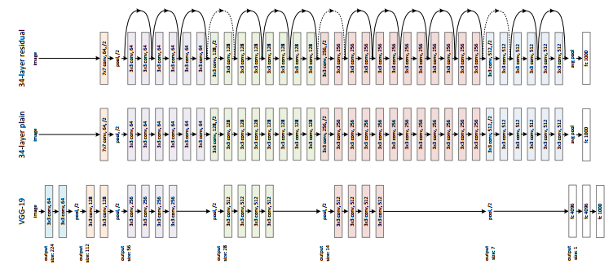
ResNet
2015 ILSVRC winner （152层）
错误率：3.57%

Slide 23
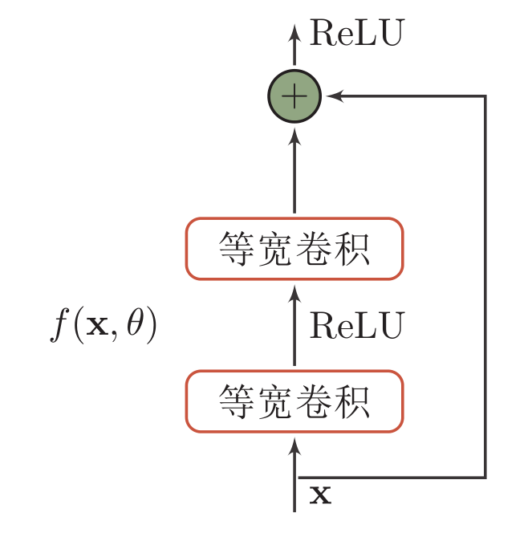
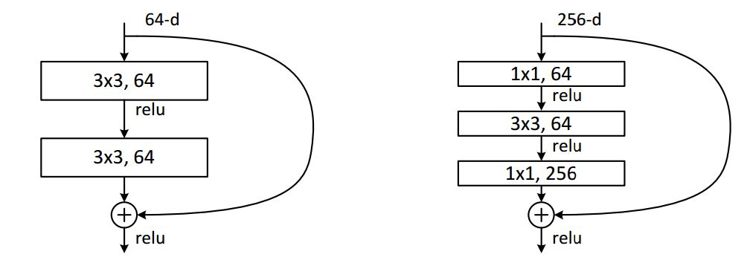
残差单元

Slide 24
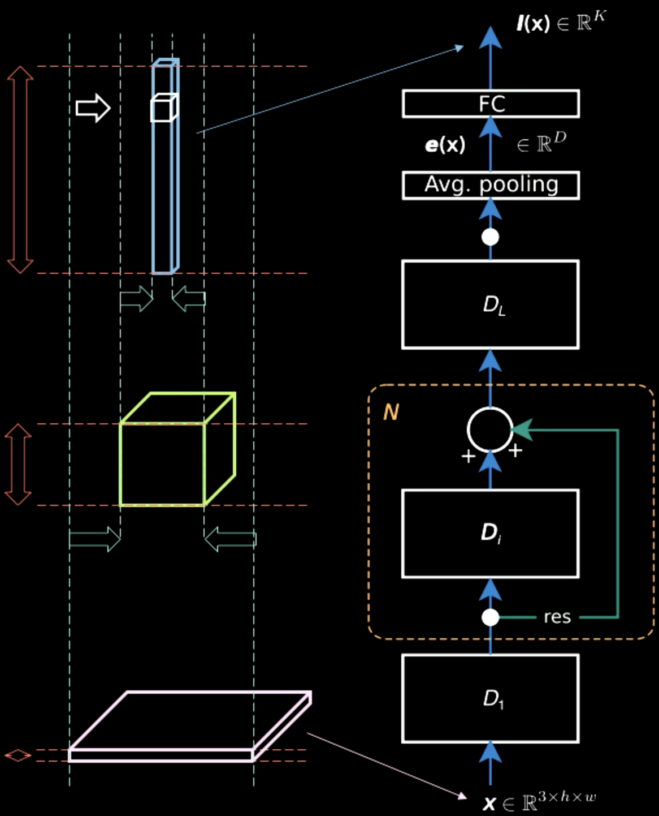
残差单元

Slide 25
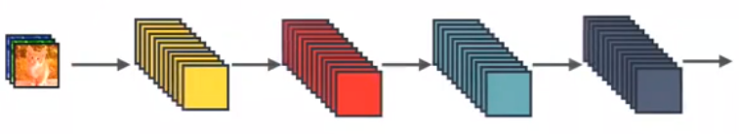
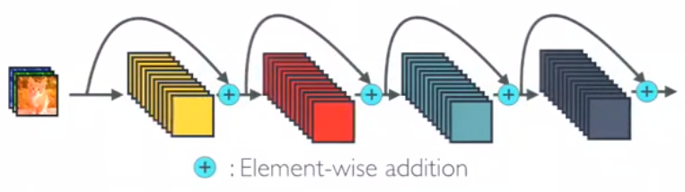
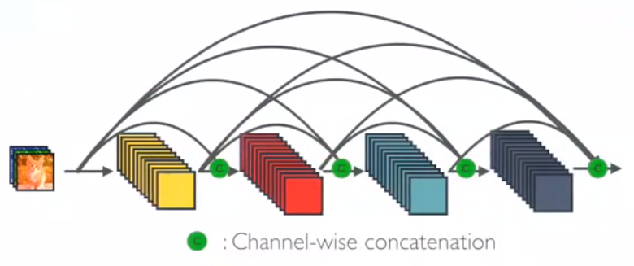
DenseNet
Standard CNN
ResNet
DenseNet

Slide 26
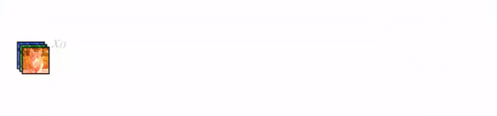
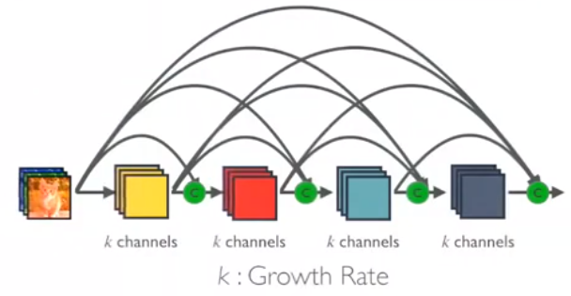
DenseNet

Slide 27
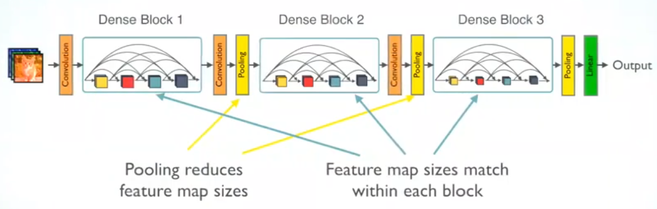
DenseNet

Slide 28
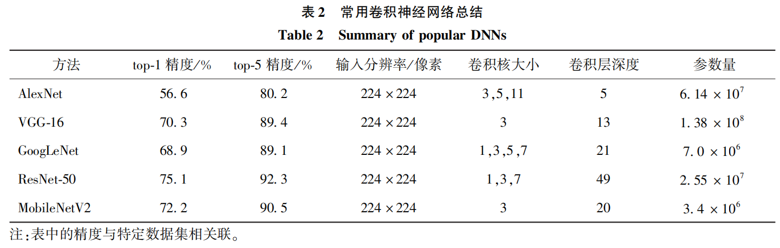
常用CNN结构

Slide 29
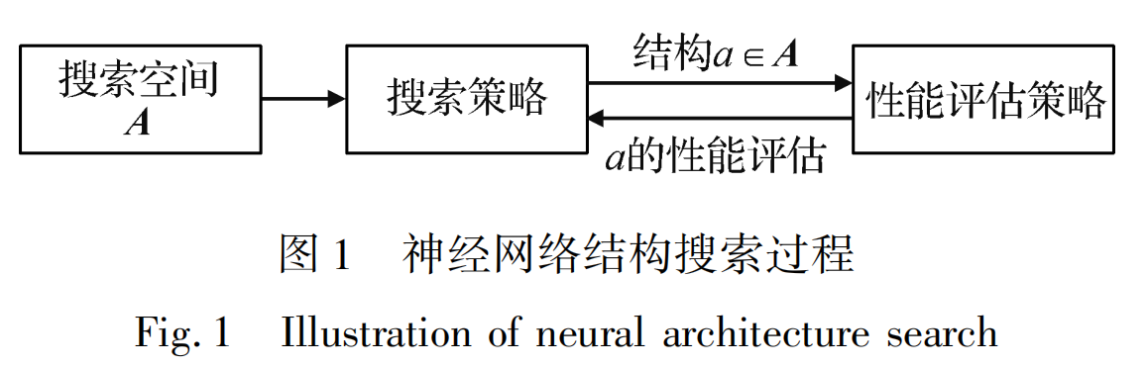
NAS

Slide 30
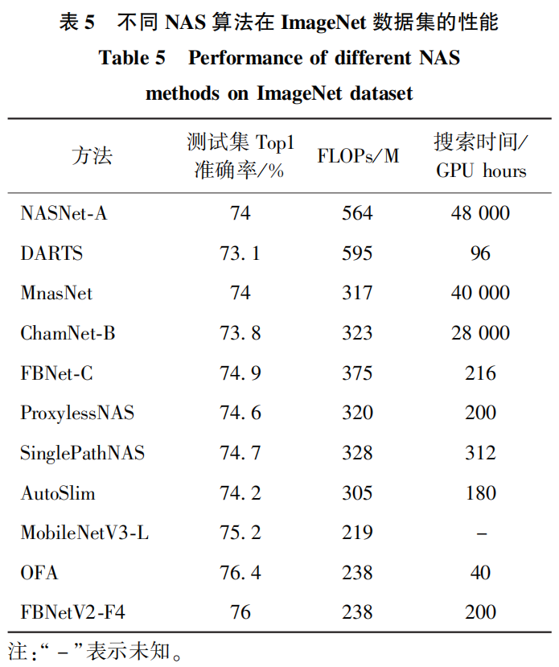
常用CNN结构

Slide 31
CNN可视化

Slide 32

CNN 可视化：滤波器
AlexNet中的滤波器（96 filters [11x11x3]）
Notes:
Example filters learned by Krizhevsky et al. Each of the 96 filters shown here is of size [11x11x3], and each one is shared by the 55*55 neurons in one depth slice. Notice that the parameter sharing assumption is relatively reasonable: If detecting a horizontal edge is important at some location in the image, it should intuitively be useful at some other location as well due to the translationally-invariant structure of images. There is therefore no need to relearn to detect a horizontal edge at every one of the 55*55 distinct locations in the Conv layer output volume.

Slide 33

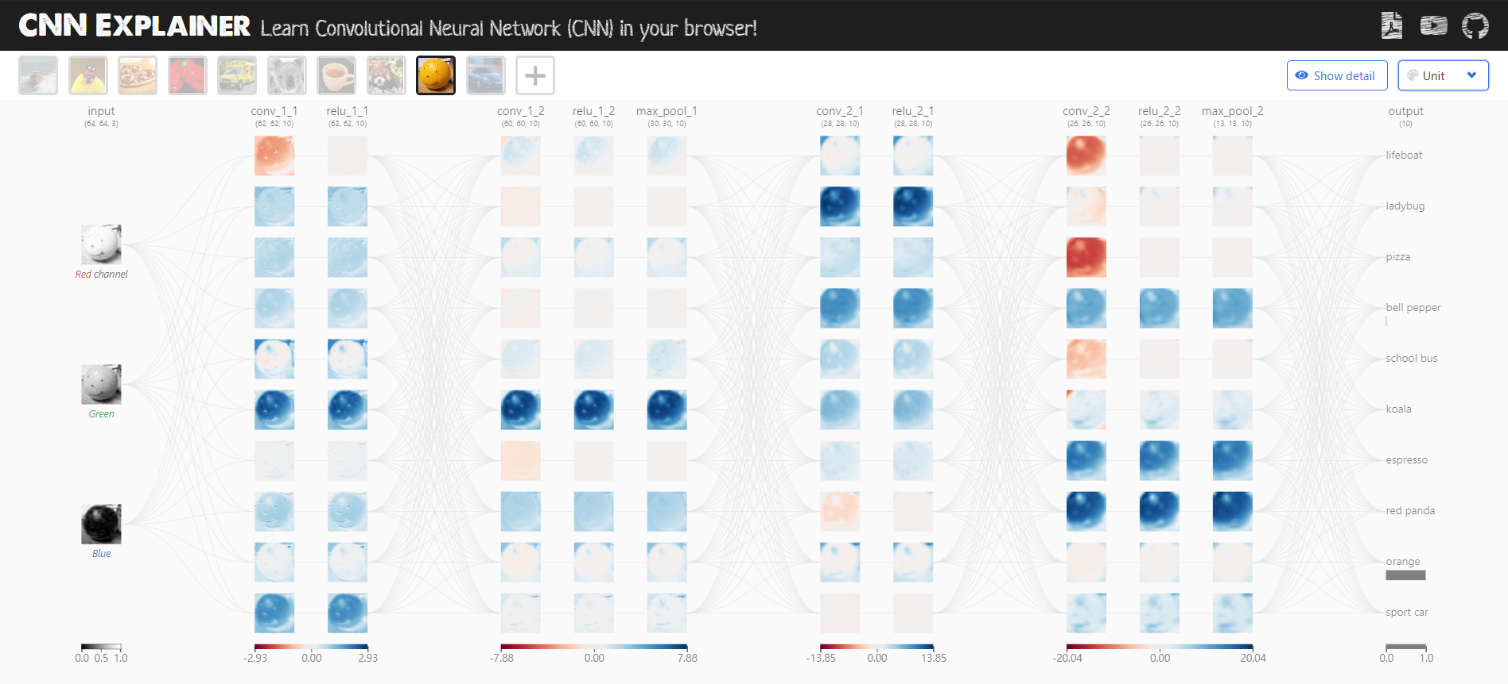
CNN 可视化：CNN Explainer 解释器
CNN解释器：https://poloclub.github.io/cnn-explainer/
GitHub：https://github.com/poloclub/cnn-explainer
论文：https://arxiv.org/abs/2004.15004
佐治亚理工 Zijie Wang
Notes:
Example filters learned by Krizhevsky et al. Each of the 96 filters shown here is of size [11x11x3], and each one is shared by the 55*55 neurons in one depth slice. Notice that the parameter sharing assumption is relatively reasonable: If detecting a horizontal edge is important at some location in the image, it should intuitively be useful at some other location as well due to the translationally-invariant structure of images. There is therefore no need to relearn to detect a horizontal edge at every one of the 55*55 distinct locations in the Conv layer output volume.

Slide 34
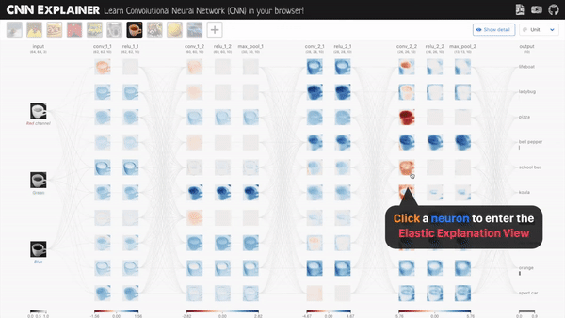
CNN 可视化：CNN Explainer 解释器
单击神经元，进入弹性解释视图，就可以看到卷积核滑动的过程的动画模拟：
Notes:
Example filters learned by Krizhevsky et al. Each of the 96 filters shown here is of size [11x11x3], and each one is shared by the 55*55 neurons in one depth slice. Notice that the parameter sharing assumption is relatively reasonable: If detecting a horizontal edge is important at some location in the image, it should intuitively be useful at some other location as well due to the translationally-invariant structure of images. There is therefore no need to relearn to detect a horizontal edge at every one of the 55*55 distinct locations in the Conv layer output volume.

Slide 35
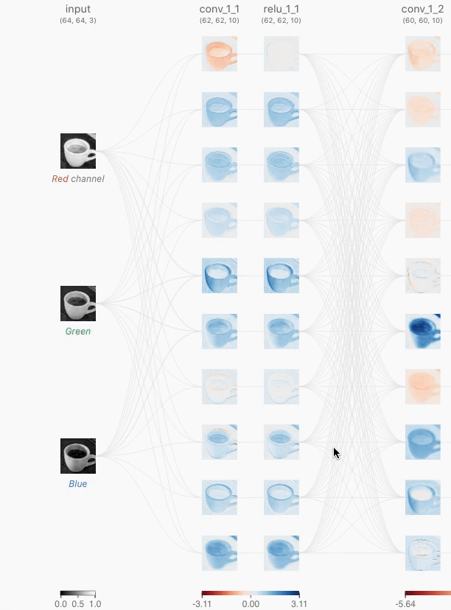
CNN 可视化：CNN Explainer 解释器
单击神经元，进入弹性解释视图，就可以看到卷积核滑动的过程的动画模拟：
Notes:
Example filters learned by Krizhevsky et al. Each of the 96 filters shown here is of size [11x11x3], and each one is shared by the 55*55 neurons in one depth slice. Notice that the parameter sharing assumption is relatively reasonable: If detecting a horizontal edge is important at some location in the image, it should intuitively be useful at some other location as well due to the translationally-invariant structure of images. There is therefore no need to relearn to detect a horizontal edge at every one of the 55*55 distinct locations in the Conv layer output volume.

Slide 36
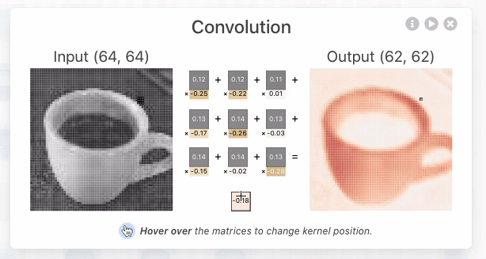
CNN 可视化：CNN Explainer 解释器
单击神经元，进入弹性解释视图，就可以看到卷积核滑动的过程的动画模拟：
Notes:
Example filters learned by Krizhevsky et al. Each of the 96 filters shown here is of size [11x11x3], and each one is shared by the 55*55 neurons in one depth slice. Notice that the parameter sharing assumption is relatively reasonable: If detecting a horizontal edge is important at some location in the image, it should intuitively be useful at some other location as well due to the translationally-invariant structure of images. There is therefore no need to relearn to detect a horizontal edge at every one of the 55*55 distinct locations in the Conv layer output volume.

Slide 37
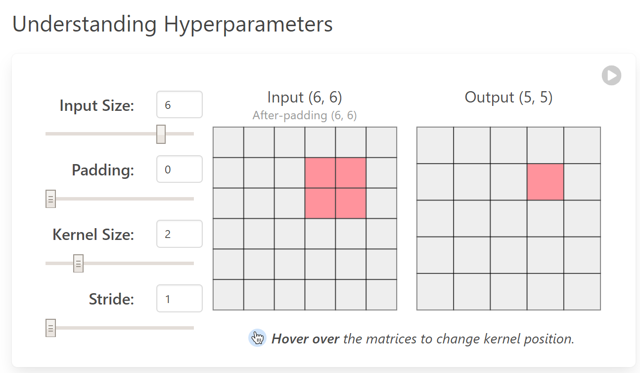
CNN 可视化：CNN Explainer 解释器
理解超参：
Notes:
Example filters learned by Krizhevsky et al. Each of the 96 filters shown here is of size [11x11x3], and each one is shared by the 55*55 neurons in one depth slice. Notice that the parameter sharing assumption is relatively reasonable: If detecting a horizontal edge is important at some location in the image, it should intuitively be useful at some other location as well due to the translationally-invariant structure of images. There is therefore no need to relearn to detect a horizontal edge at every one of the 55*55 distinct locations in the Conv layer output volume.

Slide 38
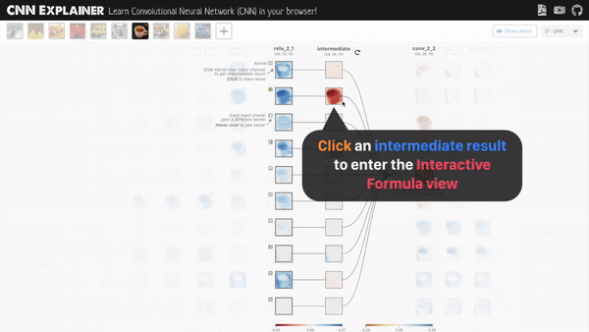
CNN 可视化：CNN Explainer 解释器
点击一个正在卷积的过程图，就可以看到更具体的过程：
Notes:
Example filters learned by Krizhevsky et al. Each of the 96 filters shown here is of size [11x11x3], and each one is shared by the 55*55 neurons in one depth slice. Notice that the parameter sharing assumption is relatively reasonable: If detecting a horizontal edge is important at some location in the image, it should intuitively be useful at some other location as well due to the translationally-invariant structure of images. There is therefore no need to relearn to detect a horizontal edge at every one of the 55*55 distinct locations in the Conv layer output volume.

Slide 39
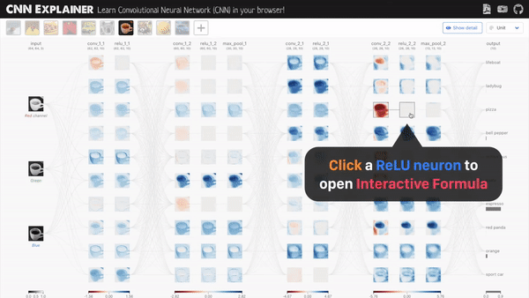
CNN 可视化：CNN Explainer 解释器
点击一个ReLU层的神经元，可以看具体过程，ReLU函数是这样工作的：
Notes:
Example filters learned by Krizhevsky et al. Each of the 96 filters shown here is of size [11x11x3], and each one is shared by the 55*55 neurons in one depth slice. Notice that the parameter sharing assumption is relatively reasonable: If detecting a horizontal edge is important at some location in the image, it should intuitively be useful at some other location as well due to the translationally-invariant structure of images. There is therefore no need to relearn to detect a horizontal edge at every one of the 55*55 distinct locations in the Conv layer output volume.

Slide 40
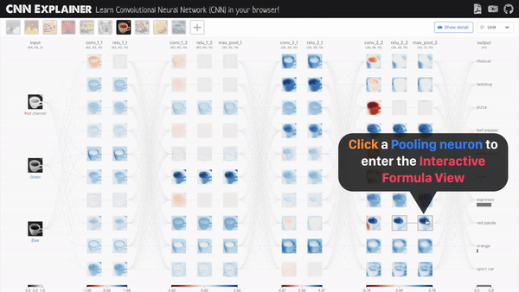
CNN 可视化：CNN Explainer 解释器
点击一个池化神经元，也可以看具体最大池化层是怎样工作的：
Notes:
Example filters learned by Krizhevsky et al. Each of the 96 filters shown here is of size [11x11x3], and each one is shared by the 55*55 neurons in one depth slice. Notice that the parameter sharing assumption is relatively reasonable: If detecting a horizontal edge is important at some location in the image, it should intuitively be useful at some other location as well due to the translationally-invariant structure of images. There is therefore no need to relearn to detect a horizontal edge at every one of the 55*55 distinct locations in the Conv layer output volume.

Slide 41
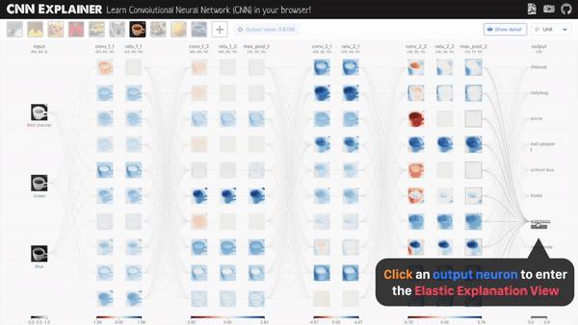
CNN 可视化：CNN Explainer 解释器
看清CNN是怎么输出预测的
点击最右侧的输出神经元，进入弹性解释视图：
Notes:
Example filters learned by Krizhevsky et al. Each of the 96 filters shown here is of size [11x11x3], and each one is shared by the 55*55 neurons in one depth slice. Notice that the parameter sharing assumption is relatively reasonable: If detecting a horizontal edge is important at some location in the image, it should intuitively be useful at some other location as well due to the translationally-invariant structure of images. There is therefore no need to relearn to detect a horizontal edge at every one of the 55*55 distinct locations in the Conv layer output volume.

Slide 42
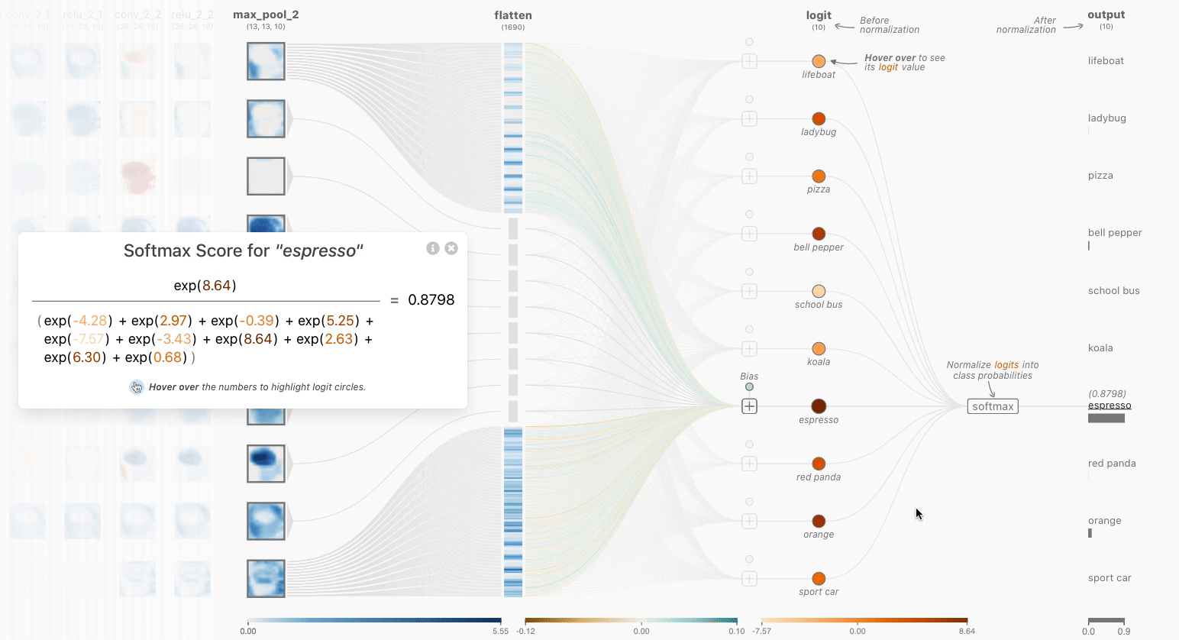
CNN 可视化：CNN Explainer 解释器
可以查看Softmax函数的详情
Notes:
Example filters learned by Krizhevsky et al. Each of the 96 filters shown here is of size [11x11x3], and each one is shared by the 55*55 neurons in one depth slice. Notice that the parameter sharing assumption is relatively reasonable: If detecting a horizontal edge is important at some location in the image, it should intuitively be useful at some other location as well due to the translationally-invariant structure of images. There is therefore no need to relearn to detect a horizontal edge at every one of the 55*55 distinct locations in the Conv layer output volume.

Slide 43

CNN 可视化：CNN Explainer 解释器
10层处理
Notes:
Example filters learned by Krizhevsky et al. Each of the 96 filters shown here is of size [11x11x3], and each one is shared by the 55*55 neurons in one depth slice. Notice that the parameter sharing assumption is relatively reasonable: If detecting a horizontal edge is important at some location in the image, it should intuitively be useful at some other location as well due to the translationally-invariant structure of images. There is therefore no need to relearn to detect a horizontal edge at every one of the 55*55 distinct locations in the Conv layer output volume.

Slide 44
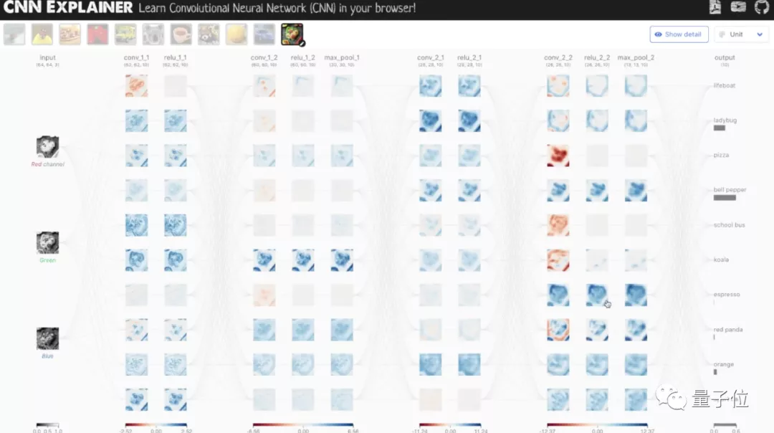
CNN 可视化：CNN Explainer 解释器
10层处理
Notes:
Example filters learned by Krizhevsky et al. Each of the 96 filters shown here is of size [11x11x3], and each one is shared by the 55*55 neurons in one depth slice. Notice that the parameter sharing assumption is relatively reasonable: If detecting a horizontal edge is important at some location in the image, it should intuitively be useful at some other location as well due to the translationally-invariant structure of images. There is therefore no need to relearn to detect a horizontal edge at every one of the 55*55 distinct locations in the Conv layer output volume.

Slide 45
CNN处理文本？

Slide 46
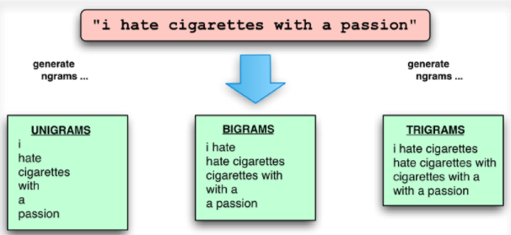
Ngram特征与卷积
如何用卷积操作来实现？

Slide 47
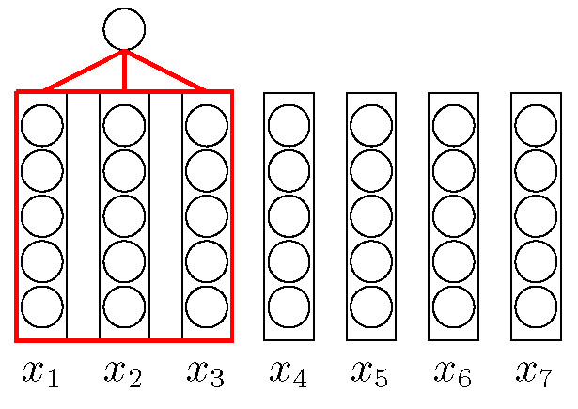
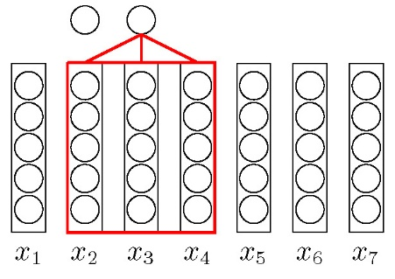
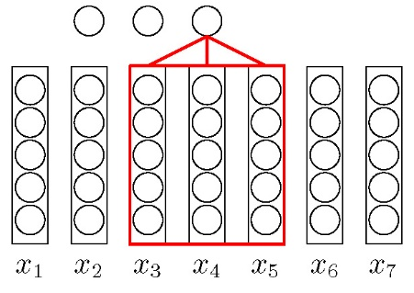
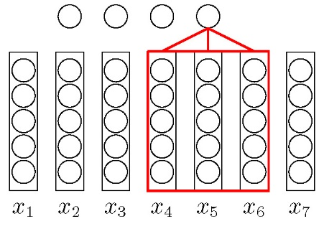

文本序列的卷积

Slide 48

基于卷积模型的句子表示
Y. Kim. “Convolutional neural networks for sentence classification”. In: arXiv preprint arXiv:1408.5882 (2014).

Slide 49


文本序列的卷积模型
输入
Filter
卷积层
Pooling层
输出

Slide 50
卷积的应用

Slide 51


AlphaGo
分布式系统：1202 个CPU 和176 块GPU
单机版：48 个CPU 和8 块GPU
走子速度：3 毫秒-2 微秒

Slide 52

目标检测（Object Detection）

Slide 53


Mask RCNN

Slide 54

OCR

Slide 55

图像生成

Slide 56


Deep Dream

Slide 57

风格迁移

Slide 58

对抗样本

Slide 59
https://nndl.github.io/

